Slide 1


Slide 2
Nth Sprint
1ST SPRINT GOALS:

Slide 3
Nth Sprint
Recap
What is Val Uni?
VAL-UNI is an Information-based platform where students can share their experiences and exchange knowledge and feedback regarding professors and courses.

Slide 4
First Sprint Objectives
Front-End
Back-End

Slide 5
Front-End
Create project template
Initial Designs
Brand Manual
React Setup
Log in page
Text box
Buttons
Logo
Animations
Back-End

Slide 6
Back-End
Setup for a functional user authentication
Connecting application to a local server database
Creating SQL database on a local server
Database schema design
Front-End

Slide 7
Implemented Features
Front-End
Back-end
Create project template
Initial Designs
Brand Manual
React Setup
Log in page
Text box
Buttons
Logo
Animations
Home Page
Setup for a functional user authentication
Connecting application to a local server database
Creating SQL database on a local server
Database schema design
Database Integration

Slide 8
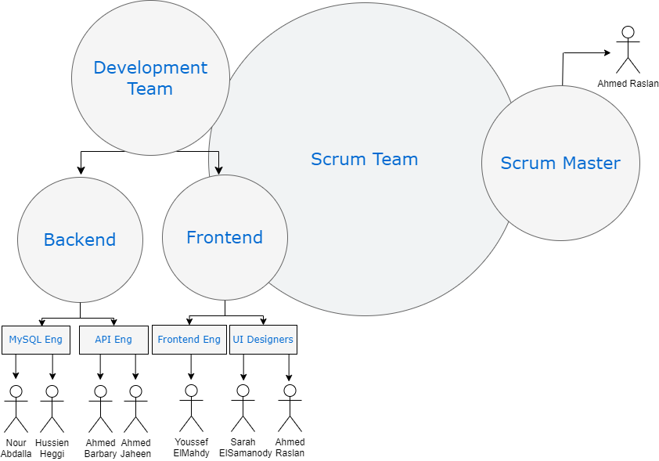
Scrum Methodology

Slide 9
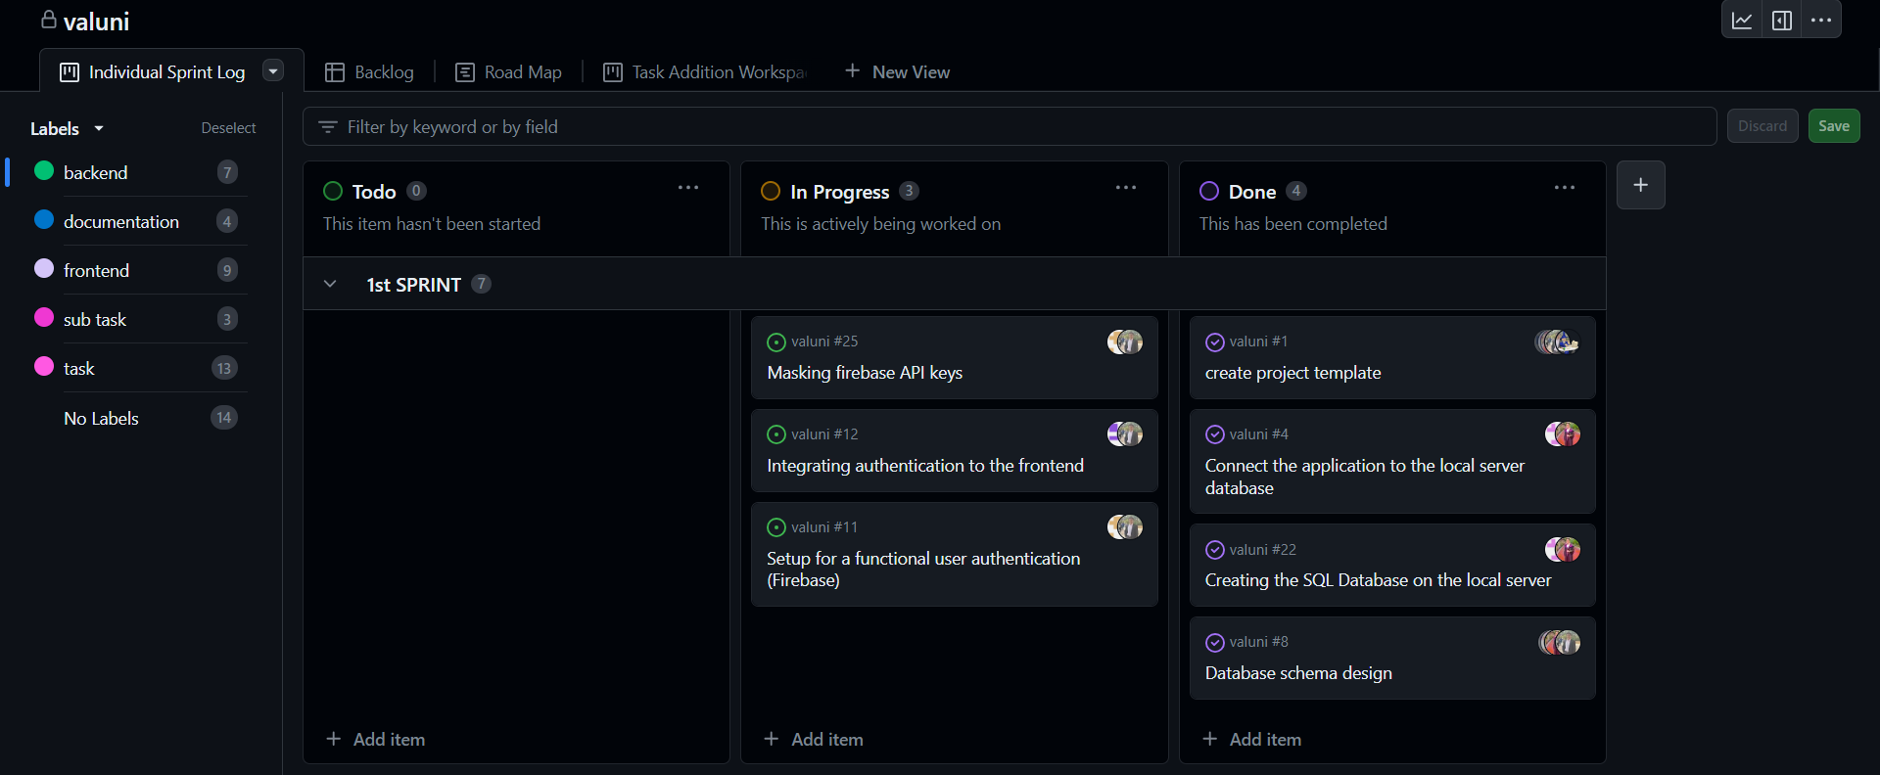
Sprint Board

Slide 10
Obstacles Faced
Front-end
Back-end

Slide 11
Obstacles Faced
Front-end
Learning how to work with react native
Setting up the working environment
Combining the separate tasks of members
Dividing the work equally

Slide 12
Obstacles Faced
Front-end
Back-end

Slide 13
Obstacles Faced
Back-end
Deciding on the technologies to use for the backend
Linking backend with frontend
Dealing with different experiences with mySQL
Communication between two teams.

Slide 14
Obstacles Solution
Front-end
Back-end

Slide 15
Obstacles Solution
Front-end
Focused on pair programming to ease up the learning process and to solve the technical issues quickly.
Divided the page components to tasks for each developer.

Slide 16
Obstacles Solution
Front-end
Back-end

Slide 17
Obstacles Solution
Back-end
Divided backend into two databases
Pair programming to ensure all members learn from each others experiences
Communicated with scrum master to deal with linking of backend and frontend

Slide 18
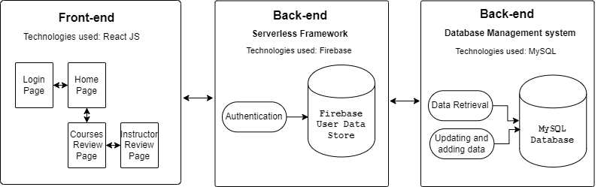
High Level Architecture

Slide 19
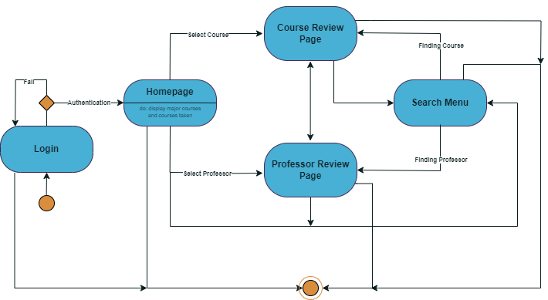
State Diagram for webpages

